Slide 1
Digital Portfolio
STUDENT NAME: SABEETHA. S
REGISTER NO AND NMID: 24134141802522030
DEPARTMENT: B.Sc. COMPUTER SCIENCE
COLLEGE: ST. THERESA’S ARTS AND SCIENCE COLLEGE

Slide 2
PROJECT TITLE
Problem Statement
Project Overview
End Users
Tools and Technologies
Portfolio design and Layout
Features and Functionality
Results and Screenshots
Conclusion
Github Link

Slide 3


AGENDA
Problem Statement
Project Overview
End Users
Tools and Technologies
Portfolio design and Layout
Features and Functionality
Results and Screenshots
Conclusion
Github Link
3/21/2024 Annual Review

Slide 4

PROBLEM STATEMENT
Create a comprehensive and accurate profile that effectively showcases an individual's skills, experience, and achievements in a clear and concise manner, while also addressing the specific needs and requirements of the intended audience."

Slide 5

PROJECT OVERVIEW
A project overview is a high-level summary of a project's objectives, scope, timelines, and deliverables. It provides a concise and clear understanding of the project's goals, stakeholders, and key components.

Slide 6

WHO ARE THE END USERS?
1. Consumers: Individuals who purchase and use products or services for personal use.2. Business users: Employees or organizations that use products or services for business purposes.3. Customers: Individuals or organizations that purchase products or services from a company.

Slide 7

TOOLS AND TECHNIQUES
HTML (Hypertext Markup Language):- Used for structuring and organizing content on the web- content and layout
CSS (Cascading Style Sheets):- Used for styling and layout of web pages- Controls the visual appearance of HTML elements, such as colors, fonts, spacing, and
JavaScript:- Used for adding interactivity and dynamic behavior to web pages- Allows for client-side scripting, enabling web pages to respond to user input, animate elements, and update content dynamically- Can be used for a wide range of tasks, from simple effects to complex applications and games

Slide 8
POTFOLIO DESIGN AND LAYOUT
Clear Navigation: Make it easy for visitors to find and view your work.
Visual Hierarchy: Use size, color, and positioning to draw attention to your most important work.
Consistent Branding: Ensure your portfolio reflects your personal brand and is consistent across all pages.
Showcase Your Best Work: Curate your portfolio to showcase your most impressive and relevant work.
8

Slide 9
FEATURES AND FUNCTIONALITY
Features:
Core Features: Essential features that provide the primary functionality of the product or system.
Secondary Features: Additional features that enhance the user experience or provide secondary functionality.
Advanced Features: Features that provide advanced functionality or customization options.
Functionality:
User Interface: The way users interact with the product or system, including navigation, input, and output.
Performance: The speed, efficiency, and reliability of the product or system.
3. Security: Measures to protect user data and prevent unauthorized access.4. Integration: The ability of the product or system to integrate with other systems or tools.

Slide 10
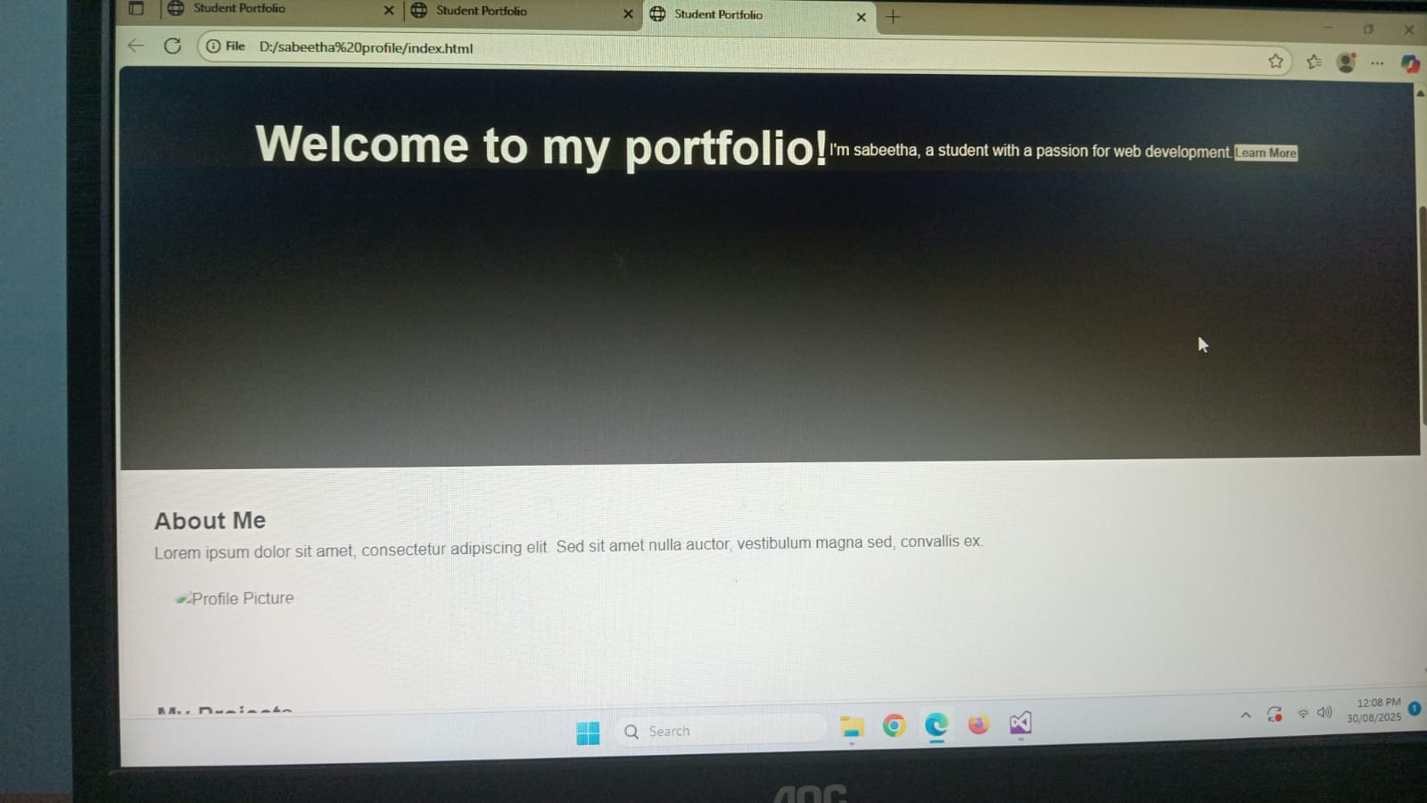

RESULTS AND SCREENSHOTS
3/21/2024 Annual Review
10

Slide 11
GITHUB LINK
https://github.com/sabeethasankarsabeetha-ship-it/Sabeetha.S-TNSDC-FWD-DP.git

Slide 12
CONCLUSION
Summarize key points: Recap the main ideas and takeaways.
Reiterate the purpose: Emphasize the importance or relevance of the topic.
Provide a final thought: Offer a parting idea or perspective.
Call to action: Encourage the reader or listener to take action.
12

